Slide 1
The Popularity of Genres
A look at Spotify’s Top 100 from 2000 to 2022

Slide 2

Data Spotify Top Hit Playlist (2010-2022)
2300 attributes
23 variables
2 playlist related (playlist_url, year)
3 track related (track_id, track_name, track_popularity)
13 track's audio features (danceability, energy, key, loudness, mode, speechiness, acousticness, instrumentalness, liveness, valence, tempo, duration_ms, time_signature)
1 album related (album)
4 artist related (artist_id, artist_name, artist_genre, artist_popularity)
Due to a vast diversity of genres, four were chosen as the major genres
Rock
Pop
Hip-hop
Other (Country, Any Euro-type, R&B, Reggaeton, etc.)

Slide 3
Proposed Question
As a producer or a label, what genre of music should be the focus of our support and promotion, especially when supporting new music?
What genre of music tends to have the most popular tracks?
What genre of music tends to have the most popular artists?
What can the data answer?
What genre of music has had the most popular tracks recently
What genre of music has had the most popular artists recently

Slide 4
Questions to Consider
When was a given genre popular?
How popular was a track in a particular genre?
How popular was an artist in a particular genre?
And then,
Which genre should be the focus?
What metrics define a genre?

Slide 5
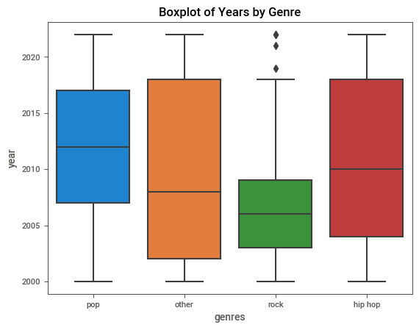
When was a given genre popular?
Hip Hop and Other maintain a consistent popularity throughout the years
Rock was popular in the past
Pop is most popular currently though… maybe

Slide 6
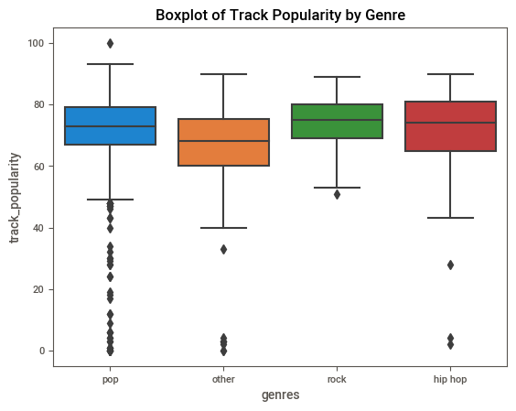
How popular was a track in a particular genre?
Pop is most popular by track with exception
Rock is more consistent

Slide 7
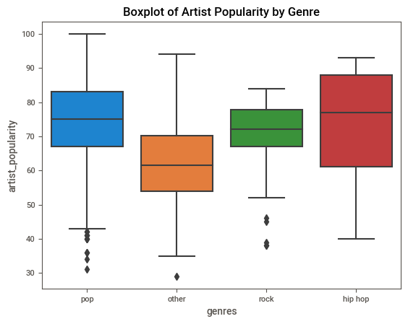
How popular was an artist in a particular genre?
Both Pop and Hip Hop promote artist popularity

Slide 8
Which Genre Should be the Focus?
It Depends:
Which is more important?
The popularity of the track,
The popularity of the artist, or
The year
New Music: Pop

Slide 9
The Metrics
acousticness - A confidence measure from 0.0 to 1.0 of whether the track is acoustic. 1.0 represents high confidence the track is acoustic.
danceability - Danceability describes how suitable a track is for dancing based on a combination of musical elements including tempo, rhythm stability, beat strength, and overall regularity. A value of 0.0 is least danceable and 1.0 is most danceable.
energy - Energy is a measure from 0.0 to 1.0 and represents a perceptual measure of intensity and activity. Typically, energetic tracks feel fast, loud, and noisy. For example, death metal has high energy, while a Bach prelude scores low on the scale. Perceptual features contributing to this attribute include dynamic range, perceived loudness, timbre, onset rate, and general entropy.
instrumentalness - Predicts whether a track contains no vocals. "Ooh" and "aah" sounds are treated as instrumental in this context. Rap or spoken word tracks are clearly "vocal". The closer the instrumentalness value is to 1.0, the greater likelihood the track contains no vocal content. Values above 0.5 are intended to represent instrumental tracks, but confidence is higher as the value approaches 1.0.
liveness - Detects the presence of an audience in the recording. Higher liveness values represent an increased probability that the track was performed live. A value above 0.8 provides strong likelihood that the track is live.
loudness - The overall loudness of a track in decibels (dB). Loudness values are averaged across the entire track and are useful for comparing relative loudness of tracks. Loudness is the quality of a sound that is the primary psychological correlate of physical strength (amplitude). Values typically range between -60 and 0 db.
speechiness - detects the presence of spoken words in a track. The more exclusively speech-like the recording (e.g. talk show, audio book, poetry), the closer to 1.0 the attribute value. Values above 0.66 describe tracks that are probably made entirely of spoken words. Values between 0.33 and 0.66 describe tracks that may contain both music and speech, either in sections or layered, including such cases as rap music. Values below 0.33 most likely represent music and other non-speech-like tracks.
tempo - The overall estimated tempo of a track in beats per minute (BPM). In musical terminology, tempo is the speed or pace of a given piece and derives directly from the average beat duration.
valence - A measure from 0.0 to 1.0 describing the musical positiveness conveyed by a track. Tracks with high valence sound more positive (e.g. happy, cheerful, euphoric), while tracks with low valence sound more negative (e.g. sad, depressed, angry).
popularity - the popularity of the song from 0 to 100

Slide 10
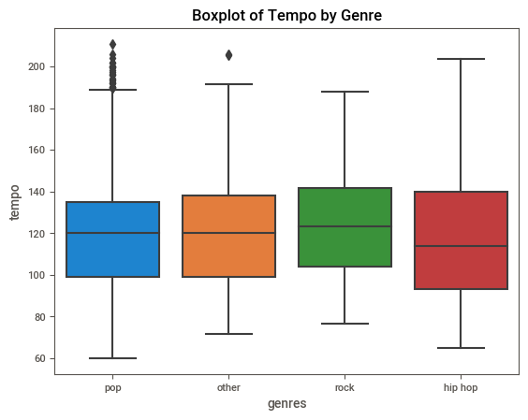
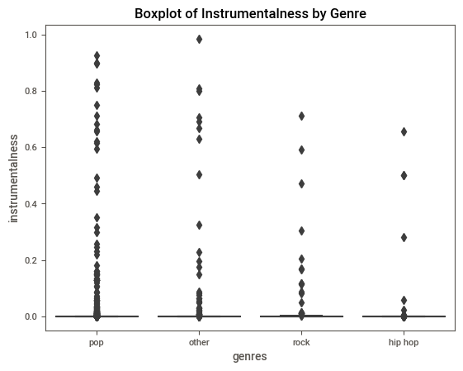
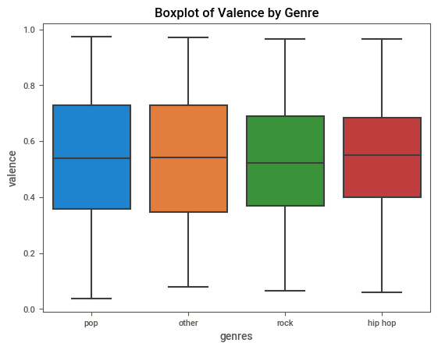
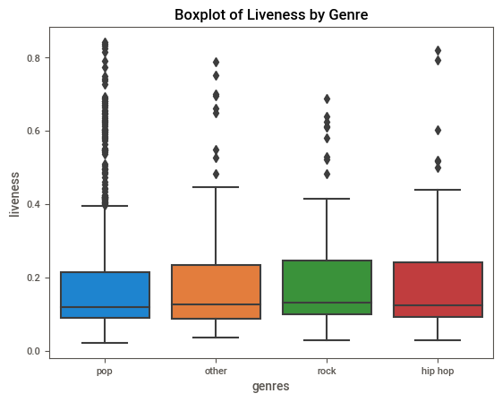
Metrics of no Difference
Measurements not to focus on. They do not differ between genres.

Slide 11
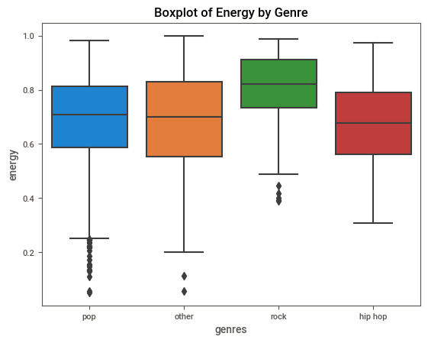
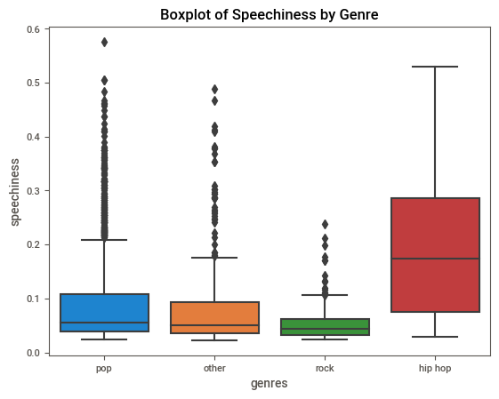
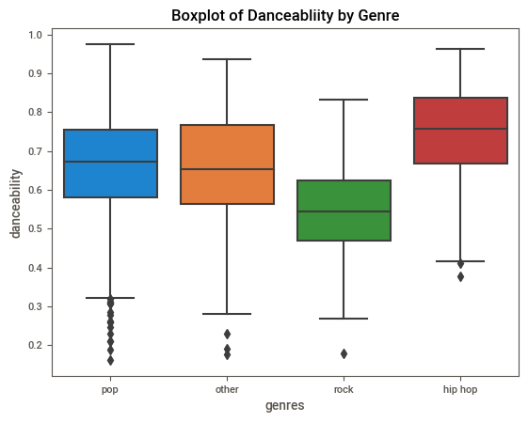
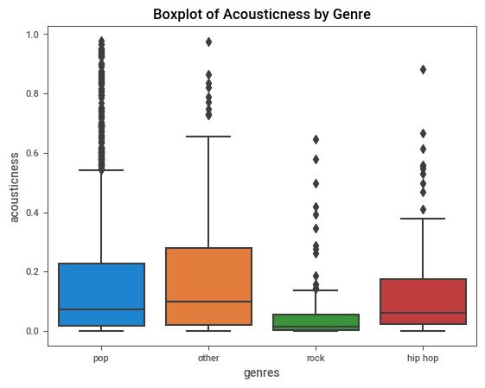
Metrics of Difference
Measurements to focus on

Slide 12
Conclusion
As a Producer looking to support music that has a high chance of being on Spotify’s Top 100, Pop is the best chance currently at finding a Track that is high in popularity.
Metrics to look for are:
High in Energy and Danceability
Low in Speechiness and Acoustics

